Slide 1


Slide 2
Meaning of Political Participation
The term political participation refers to those voluntary activities by which members of a society share in the selection of their rulers and directly or indirectly in the formation of public policy. These activities are like casting vote, seeking information , holding discussion , attending meetings, making financial contributions to political parties, staging strikes and demonstrations , communicating with the + and other leading figures.

Slide 3
DEFINITIONS
According to Rush and Althof, “Political Participation is the involvement of the individual at various levels in political system”
According to Herbert McClosky, “ Political Participation is the principal means through which consent is granted or withdrawn democracy and rulers are made accountable to the ruled”
According to Almond and Powell, “Political Participation can be defined as the members of the society in the decision making process of the system”

Slide 4
Campaign activity
Voting in election
Community activity
TYPES OF POLITICAL PARTICIPATION
Contacting officials
Protesting
Running for public office

Slide 5
Characteristics of Political participation
It is universal
It is comprehensive concept
Based on constitutional means
It is not uniform
It is voluntary
It depends upon the form of government
It provides legitimacy to administration
Negative and positive nature

Slide 6

DETERMINANTS OF POLITICAL PARTICIPATION
Education
Economic condition
Political consciousness
Ideological commitment
Immediate issues
Performance of the Government
Casteism
Religion
Populist politics

Slide 7
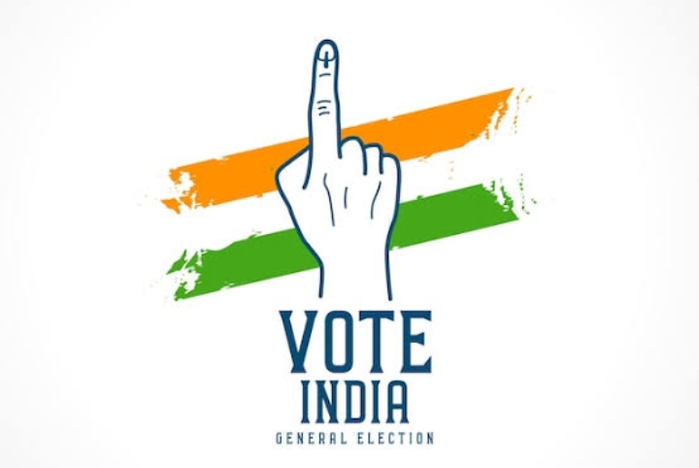
DETERMINANTS OF POLITICAL PARTICIPATION
Class interest
Charismatic leadership
Regionalism
Elections
Awareness among women
Election manifesto
Residence
Types of Government
Means of mass media

Slide 8
THANK YOU

